Slide 1
Spatial biosurveillance
Authors of Slides
Andrew Moore
Carnegie Mellon awm@cs.cmu.edu
Daniel Neill
Carnegie Mellon d.neill@cs.cmu.edu
Slides and Software and Papers at: http://www.autonlab.org
awm@cs.cmu.edu 412-268-7599
Thanks to:
Howard Burkom, Greg Cooper, Kenny Daniel, Bill Hogan, Martin Kulldorf, Robin Sabhnani, Jeff Schneider, Rich Tsui,
Mike Wagner
Note to other teachers and users of these slides. Andrew would be delighted if you found this source material useful in giving your own lectures. Feel free to use these slides verbatim, or to modify them to fit your own needs. PowerPoint originals are available. If you make use of a significant portion of these slides in your own lecture, please include this message, or the following link to the source repository of Andrew’s tutorials: http://www.cs.cmu.edu/~awm/tutorials . Comments and corrections gratefully received.

Slide 2
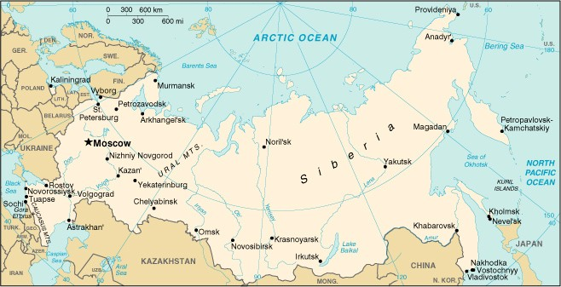
..Early Thursday Morning. Russia. April 1979...
Sverdlovsk

Slide 3
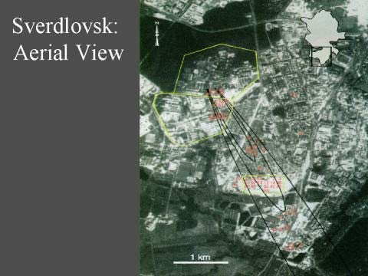
Sverdlovsk

Slide 4
Sverdlovsk
During April and May 1979, there were 77 Confirmed cases of inhalational anthrax

Slide 5
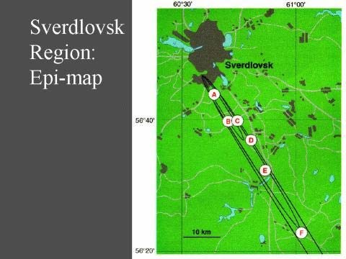

Slide 6
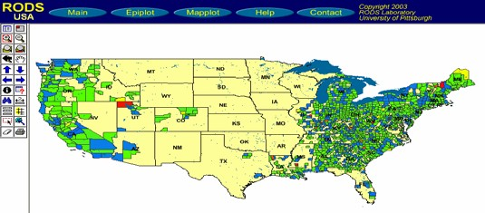
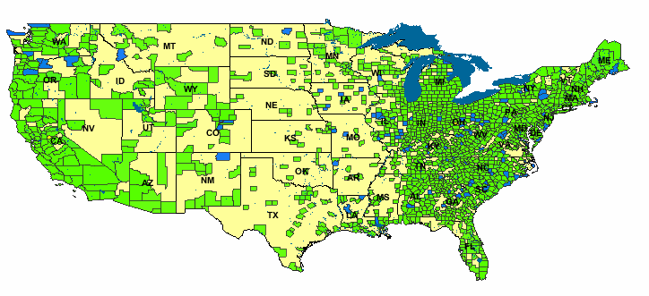
Goals of spatial cluster detection
To identify the locations, shapes, and sizes of potentially anomalous spatial regions.
To determine whether each of these potential clusters is more likely to be a “true” cluster or a chance occurrence.
In other words, is anything unexpected going on, and if so, where?

Slide 7
Disease surveillance
Given: count for each zip code
(e.g. number of Emergency Dept. visits, or over-the-counter drug sales, of a specific type)
Do any regions have sufficiently high counts to be indicative of an emerging disease epidemic in that area?
How many cases do we expect to see in each area?
Are there any regions with significantly more cases than expected?

Slide 8
A simple approach
For each zip code:
Infer how many cases we expect to see, either from given denominator data (e.g. census population) or from historical data (e.g. time series of previous counts).
Perform a separate statistical significance test on that zip code, obtaining its p-value.
Report all zip codes that are significant at some level α.
What are the potential problems?

Slide 9

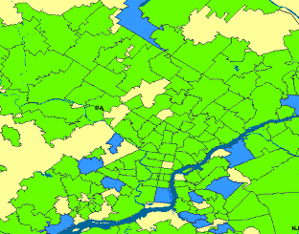
A simple approach
For e
– Inf
eit
ach zip co
er how many her from give
de:
ca n d
ses we expect
enominator d
to see, ata (e.g.
censOunesapbonoprmualal ztiipon) oBruftroa mclushteisr otof rical data
(e.g. ^{c}tºim^{de}e^{m}s^{ig}e^{ht}ri^{n}eºs^{t} of preªv^{bn}io^{or}u^{m}s^{al}c^{z}o^{ip}unts).
be interesting… codes would be!
– Perform a separate statistical significance test on that zip code, obtaining its p-value.
Report all zip codes that are significant at some level α.
What are the potential problems?

Slide 10
A simple approach
For
– In
e c
_{ode}M:ultiple hypothesis testing
each zip c
fer how man ither from giv ensus popula
Thousands of locations to test…
y
cases we expect to see,
5% chance of false positive for each…
^{en d}A^{e}lm^{n}osºt ^{m}cer^{i}t^{n}aiªn ^{t}toºg^{r}e^{d}t lªar^{t}gªe ^{(e.g.}
t data
ion) or from historical
numbers of false alarms!
(e.Hgo.wtidmo weesbeoruinedsthoefopverrealvl iporoubsabciliotyunts).
– Perform^{of} a^{get}s^{ti}e^{ng}pªa^{n}r^{y}a^{f}tªe^{lse}sªta^{la}t^{r}i^{m}s^{s}t?ical significance test on that zip code, obtaining its p-value.
Report all zip codes that are significant at some level α.
What are the potential problems?

Slide 11
One Step of Spatial Scan
Entire area being scanned

Slide 12
One Step of Spatial Scan
Entire area being scanned
Current region being considered

Slide 13

One Step of Spatial Scan
Entire area being scanned
Current region being considered
I have a population of 5300 of whom 53
are sick (1%)
Everywhere else has a population of 2,200,000 of whom 20,000 are sick (0.9%)

Slide 14
One Step of Spatial Scan
Entire area being scanned
Current region being considered
I have a population of 5300 of whom 53
are sick (1%)
So... is that a big deal?
Everywhere else has a
Evaluated with Score
population of 2,200,000 of ^{function.}
whom 20,000 are sick (0.9%)

Slide 15
Scoring functions
Define models:
of the null hypothesis H₀: no attacks.
of the alternative hypotheses H₁(S): attack in region S.

Slide 16
Scoring functions
Define models:
of the null hypothesis H₀: no attacks.
of the alternative hypotheses H₁(S): attack in region S.
Derive a score function
Score(S) = Score(C, B).
– Likelihood ratio: Sco
_{re(S ) =} L(Data | H 1(S ))
L(Data | H 0)
S* = arg max Score(S )
S
– To find the most significant region:

Slide 17
Scoring
C = Count
func^{in}t^{r}i^{e}o^{gi}n^{on}s
B = Baseline (e.g.
Population at risk)
Define models:
of the null hypothesis H₀: no attacks.
of the alternative hypotheses H₁(S): attack in region S.
Derive a score function
Score(S) = Score(C, B).
– Likelihood ratio:
_{re(S ) =} L(Data | H 1(S ))
L(Data | H 0)
S* = arg max Score(S )
S
Sco
– To find the most significant region:

Slide 18
Scoring functions
Example: Kulldorf’s score
Assumption: c ~ Poisson(qb )
i i
Define models:
of the null hypothesis H₀: no attacks.
of the alternative hypotheses H₁(S): attack in region S.
H₀: q = q_{all} everywhere
H₁: q = q_{in} inside region,
q = q_{out} outside region
Derive a score function
Score(S) = Score(C, B).
– Likelihood ratio: Sco
_{re(S ) =} L(Data | H 1(S ))
L(Data | H 0)
S* = arg max Score(S )
S
– To find the most significant region:

Slide 19
Scoring functions
Example: Kulldorf’s score
Assumption: c ~ Poisson(qb )
i i
Define models:
of the null hypothesis H₀: no attacks.
of the alternative hypotheses H₁(S): attack in region S.
H₀: q = q_{all} everywhere
H₁: q = q_{in} inside region,
q = q_{out} outside region
Derive a score function
Score(S) = Score(C, B).
– Likelihood ratio: Sco
_{re(S ) =} L(Data | H 1(S ))
L(Data | H 0)
S* = arg max Score(S )
S
– To find the most significant region:
C
D ( S ) = C log ^{C} + (C tot − C ) log ^{C tot} − C tot log ^{C tot}
B B tot − B B tot
(Individually Most Powerful statistic for detecting significant increases) (but still…just an example)

Slide 20
The generalized spatial scan
Obtain data for a set of spatial locations s_{i}.
Choose a set of spatial regions S to search.
Choose models of the data under null hypothesis H₀ (no clusters) and alternative hypotheses H₁(S) (cluster in region S).
Derive a score function F(S) based on H₁(S) and H₀.
Find the most anomalous regions (i.e. those regions S with highest F(S)).
Determine whether each of these potential clusters is actually an anomalous cluster.

Slide 21
1. Obtain data for a set of spatial locations s_{i}.
For each spatial location s_{i}, we are
•
•
c_{i} = 20,
b_{i} = 5000
given a count c_{i} and a baseline b_{i}.
For example: c_{i} = # of respiratory
disease cases, b_{i} = at-risk population.
Goal: to find regions where the counts
are higher than expected, given the baselines.
Population-based method:
Baselines represent population, whether given (e.g. census) or inferred (e.g. from sales); can be adjusted for age, risk factors, seasonality, etc.
Under null hypothesis, we expect counts to be proportional to baselines.
Expectation-based method:
Baselines represent expected counts, inferred from the time series of previous counts, accounting for day- of-week and seasonality effects.
Under null hypothesis, we expect counts to be equal to baselines.
Compare disease rate (count / pop) inside and outside region.
Compare region’s actual count to its expected count.

Slide 22
1. Obtain data for a set of spatial locations s_{i}.
c_{i} = 20,
b_{i} = 5000
For each spatial location s_{i}, we are
•
Goal: to find regions wher_{p}e_{r}t_{e}h_{f}e_{er}c_{a}ou_{b}n_{le}ts_{to use each method?}
given a count c_{i} and a baseline b_{i}.
For example: c_{i} = # of respiratory
disease cases, b_{i} = at-risk _{D}po_{is}p_{c}u_{u}la_{s}t_{s}io_{io}n_{n}.
question: When is it
are higher than expected, given the baselines.
Population-based method:
Baselines represent population, whether given (e.g. census) or inferred (e.g. from sales); can be adjusted for age, risk factors, seasonality, etc.
Under null hypothesis, we expect counts to be proportional to baselines.
Expectation-based method:
Baselines represent expected counts, inferred from the time series of previous counts, accounting for day- of-week and seasonality effects.
Under null hypothesis, we expect counts to be equal to baselines.
Compare disease rate (count / pop) inside and outside region.
Compare region’s actual count to its expected count.

Slide 23
2. Choose a set of spatial regions S to search.
Some practical considerations:
Set of regions should cover entire search space.
Adjacent regions should partially overlap.
Choose a set of regions that corresponds well with the size/shape of the clusters we want to detect.
Typically, we consider some fixed shape (e.g. circle, rectangle) and allow its location and dimensions to vary.
Don’t search too few regions:
Reduced power to detect clusters outside the search space.
Don’t search too many regions:
Overall power to detect any given subset of regions reduced because of multiple hypothesis testing.
Computational infeasibility!

Slide 24
2. Choose a set of spatial regions S to search.
Our typical approach for disease surveillance:
map spatial locations to grid
search over the set of all gridded rectangular regions.
Allows us to detect both compact and elongated clusters (important because of wind- or water- borne pathogens).
Computationally efficient
can evaluate any rectangular region in constant time
can use fast spatial scan algorithm

Slide 25
2. Choose a set of spatial regions S to search.
Our typical approach for disease surveillance:
rid
• map spatial locations to g
• search over the set of all gridded rectangular regio
Allows us to detect both compact and elongated clusters (important because of wind- or wat borne pathogens).
Computationally efficien
Can also search over non-axis-aligned rectangles by examining multiple rotations of the data
ns.
•
er-
•
t
can evaluate any rectangular region in constant time
can use fast spatial scan algorithm

Slide 26
3-4. Choose models of the data under H₀ and H₁(S), and derive a score function F(S).
Most difficult steps: must choose models which are efficiently computable and relevant.

Slide 27
3-4. Choose models of the data under H₀ and H₁(S), and derive a score function F(S).
Most difficult steps: must choose models which are efficiently computable and relevant.
F(S) must be computable as function of some additive sufficient statistics of region S,
e.g. total count C(S) and total baseline B(S).

Slide 28
3-4. Choose models of the data under H₀ and H₁(S), and derive a score function F(S).
Most difficult steps: must choose models which are efficiently computable and relevant.
tradeoff!
F(S) must be computable as function of some additive sufficient statistics of region S,
e.g. total count C(S) and total baseline B(S).
Any simplifying assumptions should not greatly affect our ability to distinguish between clusters and non-clusters.

Slide 29
3-4. Choose models of the data under H₀ and H₁(S), and derive a score function F(S).
Most difficult steps: must choose models which are efficiently computable and relevant.
tradeoff!
F(S) must be computable as function of some additive sufficient statistics of region S,
e.g. total count C(S) and total baseline B(S).
Any simplifying assumptions should not greatly affect our ability to distinguish between clusters and non-clusters.
Iterative design process
Test detection
Remove effect (preprocessing)?
Filter out regions (postprocessing)?
Add complexity to model?
power
Y Calibrate
Basic model
High power?
Done
N
Find unmodeled effect harming performance

Slide 30
3-4. Choose models of the data under H₀ and H₁(S), and derive a score function F(S).
Most difficult steps: must choose models which are efficiently computable and relevant.
Discussion question: What effects
F(S) must sbhe ocoumldpubtaebletraesaftuendctiownitohf eachAntyescimhpnliifqyuineg?assumptions should not
tradeoff!
some additive sufficient statistics of region S,
e.g. total count C(S) and total baseline B(S).
greatly affect our ability to distinguish between clusters and non-clusters.
Iterative design process
Test detection
Remove effect (preprocessing)?
Filter out regions (postprocessing)?
Add complexity to model?
power
Y Calibrate
Basic model
High power?
Done
N
Find unmodeled effect harming performance

Slide 31
Computing the score function
Method 1 (Frequentist, hypothesis testing approach):
Use likelihood ratio
_{F (S ) =} Pr(Data | H₁ (S ))
Pr(Data | H₀ )
Prior probability of region S
Method 2 (Bayesian approach):
Use posterior probability
_{F (S ) =} Pr(Data | H₁ (S )) Pr(H₁ (S ))
Pr(Data)
What to do when each hypothesis has a parameter space Θ?
Method A (Maximum likelihood approach)
Pr(Data | H ) = max_{θ∈Θ( H )} Pr(Data | H ,θ )
Method B (Marginal likelihood approach)
Pr(Data | H ) = ∫ Pr(Data | H ,θ ) Pr(θ )
θ∈Θ( H )

Slide 32
Computing the score function
Method 1 (Frequentist, hypothesis testing approach):
Use likelihood ratio
_{F (S ) =} Pr(Data | H₁ (S ))
Pr(Data | H₀ )
Most common (frequentist) approach: use likelihood ratio statistic, with maximum likelihood estimates of any free parameters, and compute statistical significance by randomization.
Method A (Maximum likelihood approach)
Pr(Data | H ) = max_{θ∈Θ( H )} Pr(Data | H ,θ )

Slide 33
5. Find the most anomalous regions, i.e. those regions S with highest F(S).
Naïve approach: compute F(S) for each spatial
region S.
Problem: millions of regions to search!
Better approach: apply fancy algorithms (e.g. Kulldorf’s SatScan or the fast spatial scan algorithm (Neill and Moore, KDD 2004).

Slide 34








5. Find the most anomalous regions, i.e. those regions S with highest F(S).
Naïve approach: compute F(S) for each spatial
region S.
Problem: millions of regions to search!
Better approach: apply fancy algorithms (e.g. Kulldorf’s SatScan or the fast spatial scan algorithm (Neill and Moore, KDD 2004).
Start by examining large rectangular regions S. If we can show that none of the smaller rectangles contained in S can have high scores, we do not need to individually search each of these subregions.
Using a multiresolution data structure (overlap-kd tree) enables us to efficiently move between searching at coarse and fine resolutions.

Slide 35
5. Find the most anomalous regions, i.e.
those regions S with highest F(S).
Result: 20-2000x speedups
•vsN. anïaveïveapapprporaocahc:hc,owmitphuotuet F(S) for each spatial
anreygloiosns So.f accuracy
Problem: millions of regions to search!
Better approach: apply fancy algorithms (e.g. Kulldorf’s SatScan or the fast spatial scan algorithm (Neill and Moore, KDD 2004).
Start by examining large rectangular regions S. If we can show that none of the smaller rectangles contained in S can have high scores, we do not need to individually search each of these subregions.
Using a multiresolution data structure (overlap-kd tree) enables us to efficiently move between searching at coarse and fine resolutions.

Slide 36
6. Determine whether each of these potential clusters is actually an anomalous cluster.
Frequentist approach: calculate statistical significance of each region by randomization testing.
D(S) = 21.2
D(S) = 15.1
D(S) = 18.5
Original grid G

Slide 37
6. Determine whether each of these potential clusters is actually an anomalous cluster.
Frequentist approach: calculate statistical significance of each region by randomization testing.
D(S) = 21.2
D(S) = 15.1
D(S) = 18.5
…
D*(G₁) = 16.7
D*(G₉₉₉) = 4.2
1. Create R = 999 replica grids by sampling under H₀, using max-likelihood estimates of any free params.
Original grid G

Slide 38
6. Determine whether each of these potential clusters is actually an anomalous cluster.
Frequentist approach: calculate statistical significance of each region by randomization testing.
D(S) = 21.2
D(S) = 15.1
D(S) = 18.5
…
D*(G₁) = 16.7
D*(G₉₉₉) = 4.2
Create R = 999 replica grids by sampling under H₀, using max-likelihood estimates of any free params.
Find maximum region score D* for each replica.
Original grid G

Slide 39
6. Determine whether each of these potential clusters is actually an anomalous cluster.
Frequentist approach: calculate statistical significance of each region by randomization testing.
D(S) = 21.2
D(S) = 15.1
D(S) = 18.5
…
D*(G₁) = 16.7
D*(G₉₉₉) = 4.2
Create R = 999 replica grids by sampling under H₀, using max-likelihood estimates of any free params.
Find maximum region score D* for each replica.
For each potential cluster S, count R_{beat} = number of replica grids G’ with D*(G’) higher than D(S).
p-value of region S = (R_{beat}+1)/(R+1).
All regions with p-value < α are significant at level α.
Original grid G

Slide 40
6. Determine whether each of these potential clusters is actually an anomalous cluster.
Bayesian approach: calculate posterior probability of each potential cluster.
Score of region S = Pr(Data | H₁(S)) Pr(H₁(S))
Total probability of the data: Pr(Data) = Pr(Data | H₀) Pr(H₀) + ∑_{S} Pr(Data | H₁(S)) Pr(H₁(S))
Posterior probability of region S: Pr(H₁(S) | Data) = Pr(Data | H₁(S)) Pr(H₁(S)) / Pr(Data).
Report all clusters with posterior probability > some threshold, or “sound the alarm” if total
posterior probability of all clusters sufficiently high.
Original grid G
No randomization testing necessary… about 1000x faster than naïve frequentist approach!

Slide 41
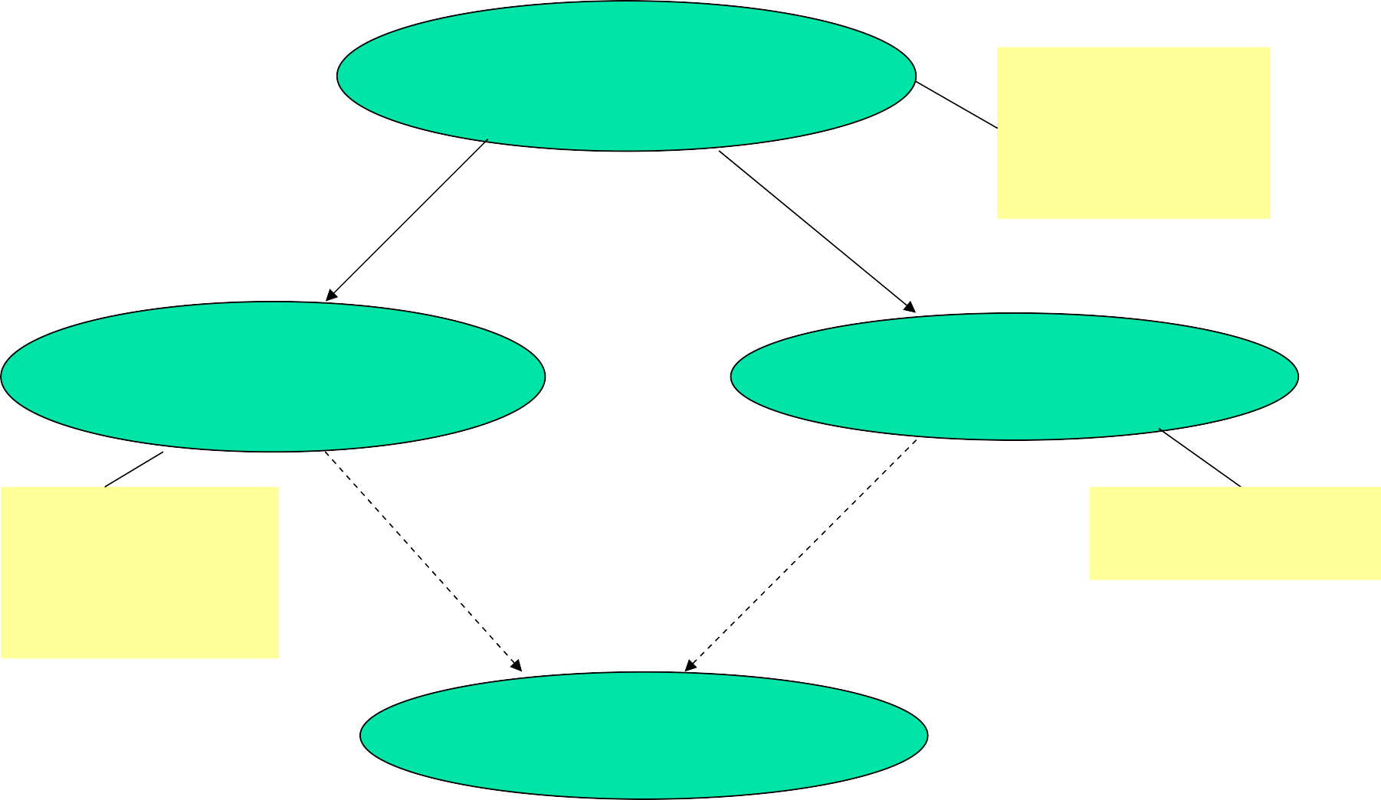
Making the spatial scan fast
256 x 256 grid = 1 billion regions!
Naïve frequentist scan
1000 replicas
x 12 hrs / replica
= 500 days!
Fast frequentist scan
Naïve Bayesian scan
1000 replicas
x 36 sec / replica
= 10 hrs
12 hrs (to search original grid)
Fast Bayesian scan

Slide 42

Why the Scan Statistic speed obsession?
Traditional Scan Statistics very expensive, especially with Randomization tests
Going national
A few hours could actually matter!

Slide 43
Results

Slide 44

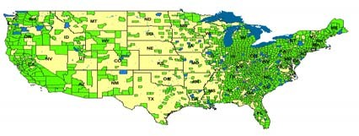
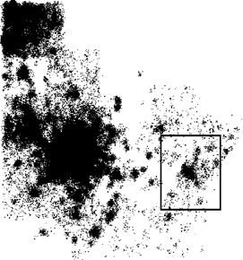
Summary of results
The fast spatial scan results in huge speedups (as compared to exhaustive search), making fast real-time detection of clusters feasible.
No loss of accuracy: fast spatial scan finds the exact same regions and p-values as exhaustive search.
OTC data from National Retail Data Monitor
ED data

Slide 45
Performance comparison
Algorithm name | Search space | Number of regions | Search time (total) | Time / region | Likelihood ratio
SaTScan | Circles centered at datapts | 150 billion | 16 hours | 400 ns | 413.56
exhaustive | Axis- aligned rectangles | 1.1 trillion | 45 days | 3600 ns | 429.85
fast spatial scan | Axis- aligned rectangles | 1.1 trillion | 81 minutes | 4.4 ns | 429.85
On ED dataset (600,000 records), 1000 replicas
For SaTScan: M=17,000 distinct spatial locations
For Exhaustive/fast: 256 x 256 grid

Slide 46
Performance comparison
Algorithm name | Search space | Number of regions | Search time (total) | Time / region | Likelihood ratio
SaTScan | Circles centered at datapts | 150 billion | 16 hours | 400 ns | 413.56
exhaustive | Axis- aligned rectangles | 1.1 trillion | 45 days | 3600 ns | 429.85
fast spatial scan | Axis- aligned rectangles | 1.1 trillion | 81 minutes | 4.4 ns | 429.85
On ED dataset (600,000 records), 1000 replicas
For SaTScan: M=17,000 distinct spatial locations
For Exhaustive/fast: 256 x 256 grid
Algorithms: Neill and Moore, NIPS 2003, KDD 2004
Deployment: Neill, Moore, Tsui and Wagner, Morbidity and Mortality Weekly Report, Nov. ‘04

Slide 47






d-dimensional partitioning
Parent region S is divided into 2d overlapping children: an “upper child” and a “lower child” in each dimension.
Then for any rectangular subregion S’ of S, exactly one of the following is true:
S₁
S₅
S₂
S’ is contained entirely in (at least) one of the children S₁… S_{2d}.
S’ contains the center region S_{C}, which
S₃
S
is common to all the children.
Starting with the entire grid G and repeating this partitioning recursively, we obtain the overlap-kd tree structure.
S₄
S_{C}
S₆
Algorithm: Neill, Moore and Mitchell NIPS 2004

Slide 48
Limitations of the algorithm
Data must be aggregated to a grid.
Not appropriate for very high- dimensional data.
Assumes that we are interested in finding (rotated) rectangular regions.
Less useful for special cases (e.g. square regions, small regions only).
Slower for finding multiple regions.

Slide 49
Related work
non-specific clustering: evaluates general tendency of data to cluster
focused clustering: evaluates risk w.r.t. a given spatial location (e.g. potential hazard)
disease mapping: models spatial variation in risk by applying spatial smoothing.
spatial scan statistics (and related techniques).

